Slide 1



Ethics in IT
Class IX
lab 2

Slide 2

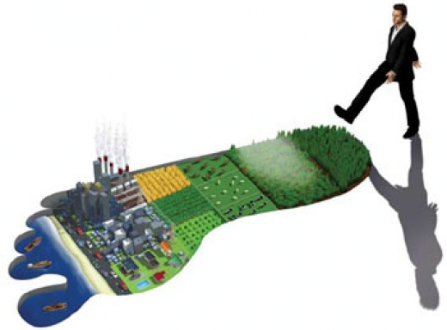
Footprinting
Footprinting is used for gathering possible information about a target

Slide 3
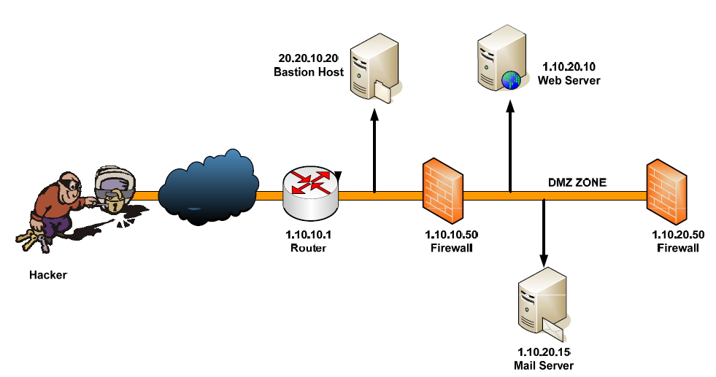
Collecting Information

Slide 4
Results from Footprinting
- Domain name - IP Addresses - Namespaces - Employee information - Phone numbers - E-mails
- Job Information

Slide 5
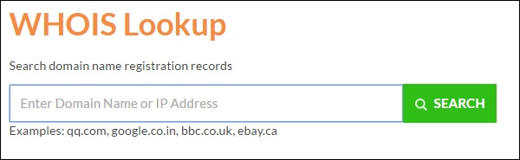
DNS
keep your domain name profile a private one which should hide the information from potential hackers

Slide 6
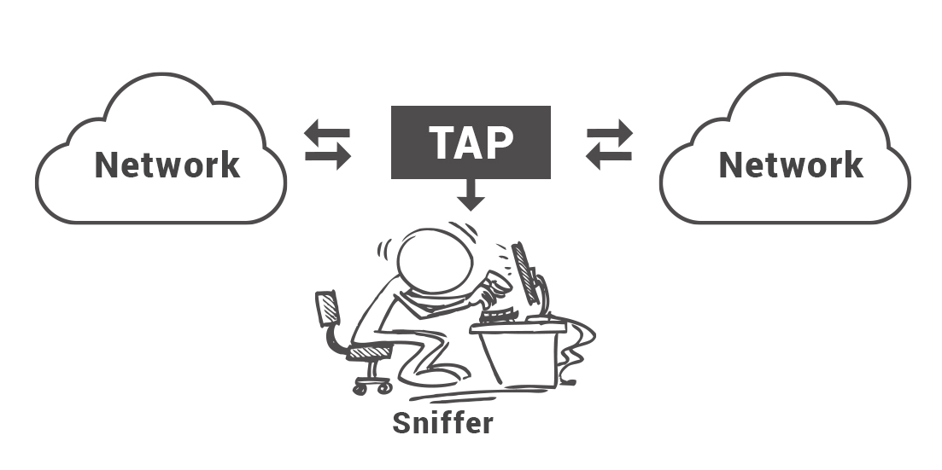
Sniffing
the process of monitoring and capturing all the packets passing through a given network using
sniffing tools

Slide 7
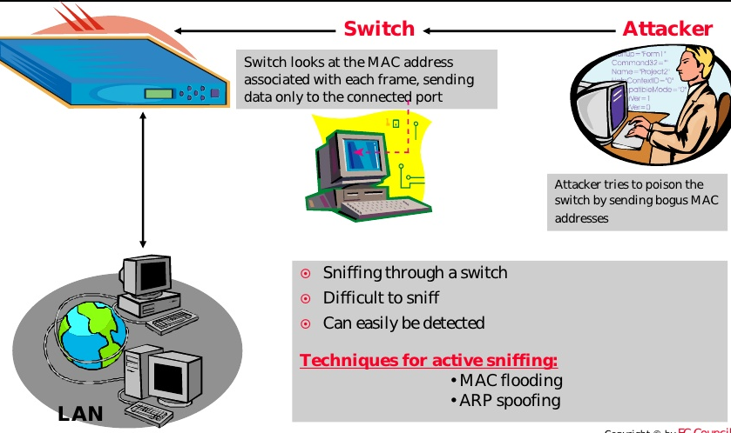
Active Sniffing

Slide 8
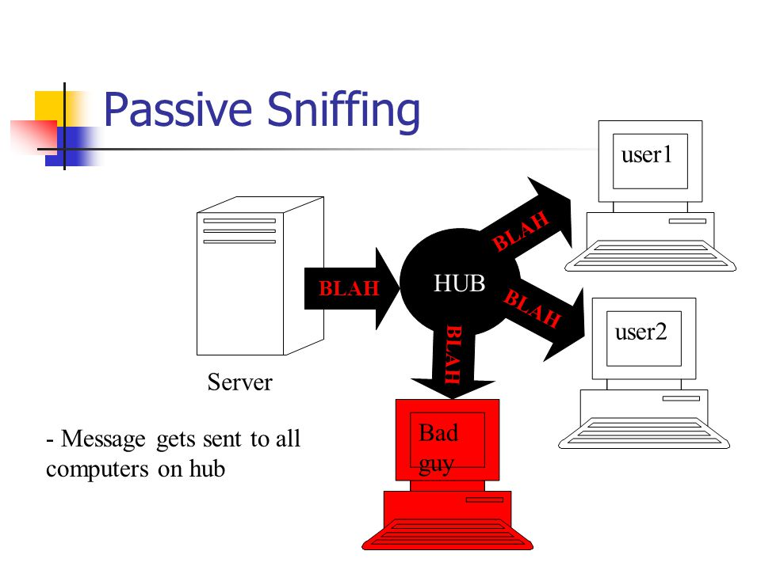
Passive Sniffing

Slide 9



